Slide 1
Home automation with chatbots
Presented By : The Assembly Team

Slide 2
Introduction
OBJECTIVE: Create a simple chatbot to control a set of sensors from your phone.
A chatbot is a service, powered by rules and sometimes artificial intelligence, that you interact with via a chat interface. The service could be any number of things, ranging from functional to fun, and it could live in any major chat product (Facebook Messenger, Slack, Telegram, Text Messages, etc.). Fun fact- One of the first bot that were created and tested was Eliza and dates all the way to the 1960's.

Slide 3



Introduction to Telegram and Bot API
Bots are third-party applications that run inside Telegram. Users can interact with bots by sending them messages, commands and inline requests. You control your bots using HTTPS requests to their botAPI.
There are a few different platforms that allow you to build your own chatbot. Telegram is simplest to use and is also growing steadily in popularity.
Notes:
The main idea of chatbots is that instead of having to dig through awkward mobile menus and learn UIs, you'll simply have a conversation with a bot through a familiar instant messaging interface.

Slide 4

Interactions between chatbots
https://www.youtube.com/watch?v=vphmJEpLXU0
https://www.youtube.com/watch?v=WnzlbyTZsQY
https://www.youtube.com/watch?v=CU9iPp52hj0

Slide 5
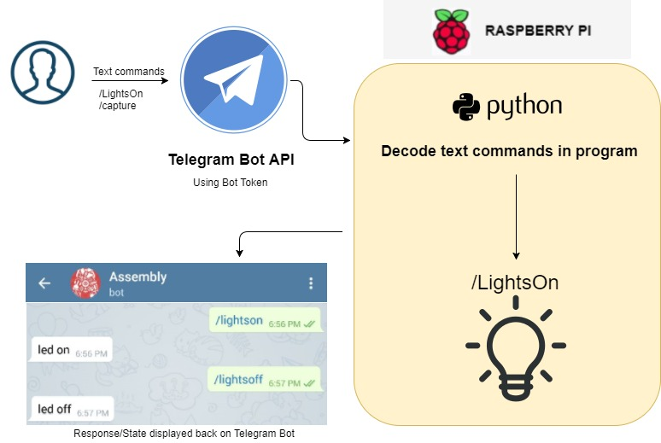
Flowchart

Slide 6
Github repository
To get the instructions and other files go to:
https://github.com/The-Assembly/Home_automation_chatbot

Slide 7
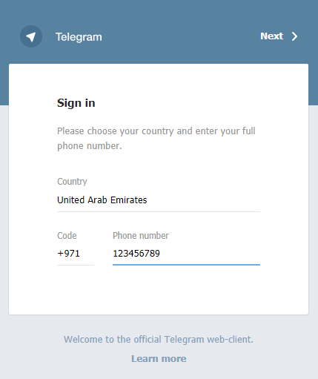

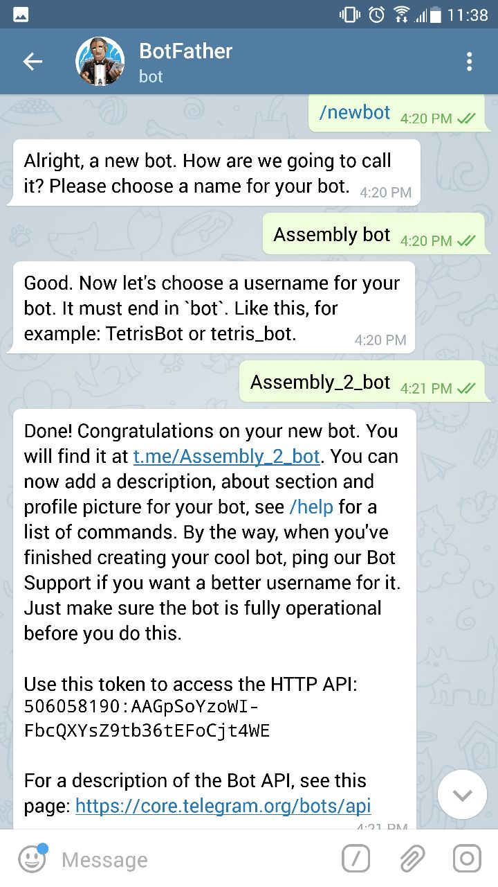
Setting up a chat bot through Telegram
Visit web.telegram.org or download the app from the App Store.
Create a new account
Search for botFather

Slide 8
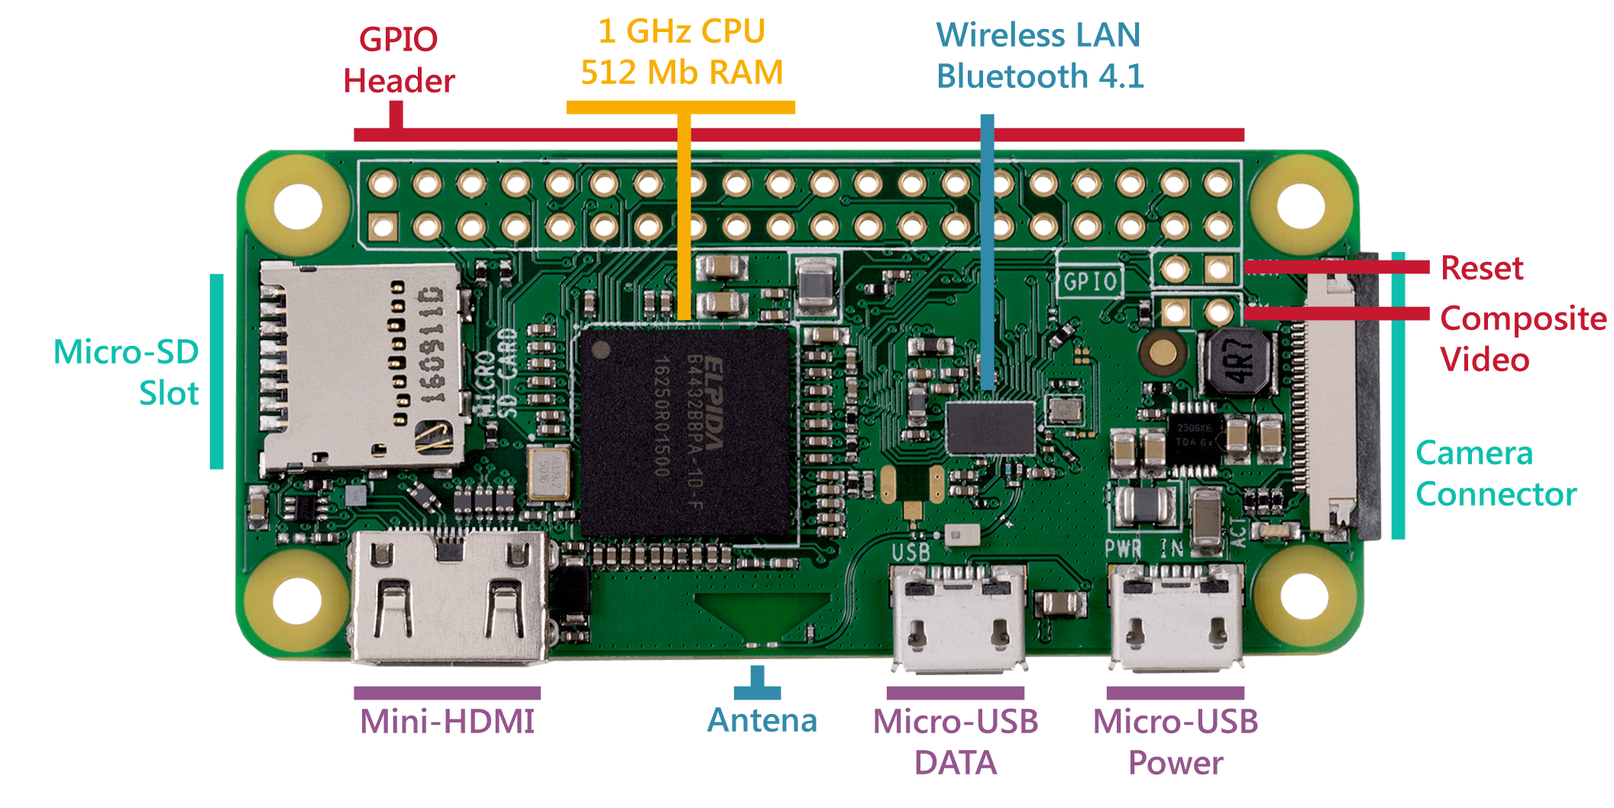
The Raspberry PI Zero W
Notes:
The introduction of the Raspberry Pi Zero allowed one to embed an entire computer in even smaller projects. This guide will cover the latest version of the Zero product line, the Raspberry Pi Zero - Wireless, which has an onboard WiFi module. While these directions should work for most any version and form factor of the Raspberry Pi, it will revolve around the Pi Zero W.
Additional Connections
Last, you may notice two sets of thruhole pads labeled TV and Run. The TV pads allow you to connect an RCA jack to the board instead of using the HDMI out. The Run pins connect to the chips reset pin and will either turn the board off or turn it back on once it has been shutdown. Connecting a button here is a good way to power cycle your board.
Main Website - https://www.raspberrypi.org/products/raspberry-pi-zero-w/
Arduino vs Raspberry PI - https://makezine.com/2015/12/04/admittedly-simplistic-guide-raspberry-pi-vs-arduino/ ; https://circuitdigest.com/article/arduino-vs-raspberryp-pi-difference-between-the-two
Raspberry PI OS - https://lifehacker.com/the-best-operating-systems-for-your-raspberry-pi-projec-1774669829
Raspberry PI Zero- https://learn.sparkfun.com/tutorials/getting-started-with-the-raspberry-pi-zero-wireless

Slide 9
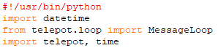
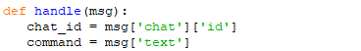
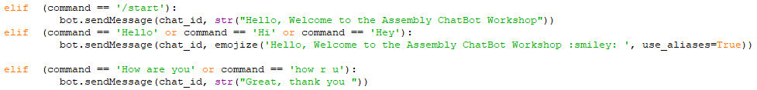
A few simple commands to begin with
Include libraries
Install necessary packages:
- sudo apt-get install python-pip
- pip install telepot
Define handler function
Define commands and bot response

Slide 10
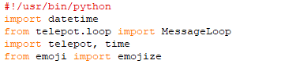
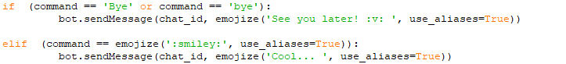
A few simple commands to begin with
Include libraries
Install necessary packages:
- pip install emoji --upgrade
Define handler function
Define commands and bot response

Slide 11
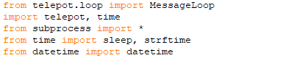
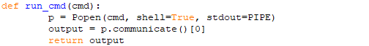
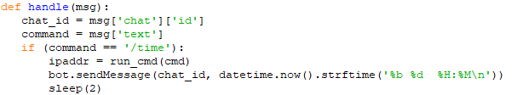
A simple Time program
Include libraries
Set up a path to communicate with the Pi
Define message handler and Bot response

Slide 12


Light Emitted Diode
Semi-conductor device
Longer end -> positive end (anode)
Shorter end -> negative end (cathode)
Notes:
Read more https://learn.sparkfun.com/tutorials/light-emitting-diodes-leds
http://whatis.techtarget.com/definition/light-emitting-diode-LED

Slide 13
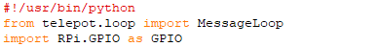
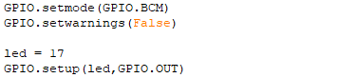
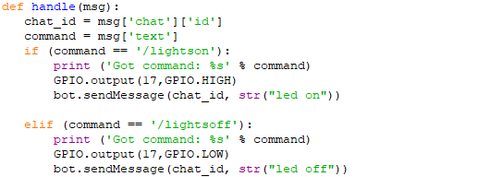
Controlling lights
Include libraries
Define GPIO mode and pins
Define handler function, LED output, and Bot response

Slide 14
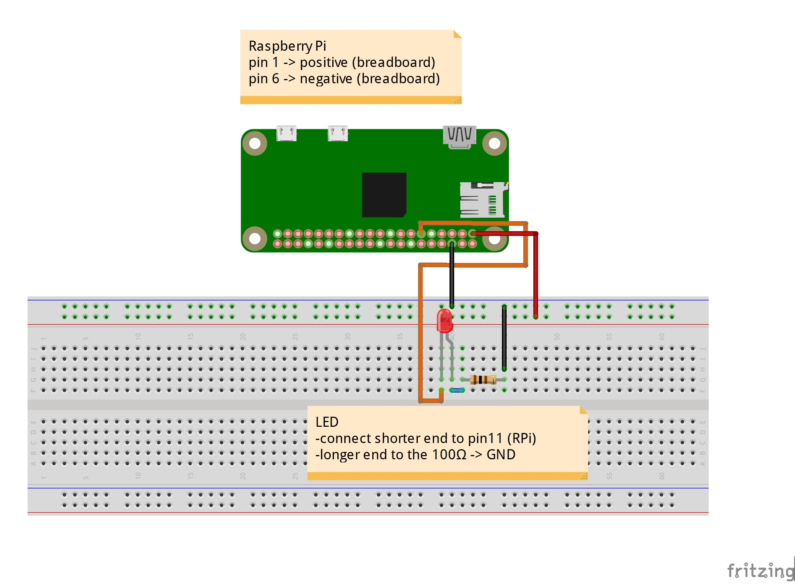
Circuit diagram for LED

Slide 15
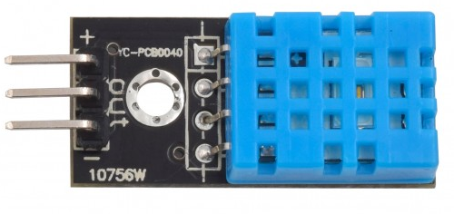
DHT11 - Temp & Humidity Sensor
Measure your surrounding air temperature and relative humidity
Mounted 10kΩ pull up resistor
Good for 20-80% humidity readings with 5% accuracy
Good for 0-50°C temperature readings ±2°C accuracy
Notes:
Read more https://www.smart-prototyping.com/DHT11-Humidity-and-Temperature-Sensor-Module
Example with Arduino: https://www.smart-prototyping.com/blog/DHT11-Temperature-and-Humidity-Sensor-with-an-Arduino-Uno

Slide 16
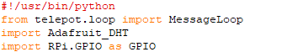
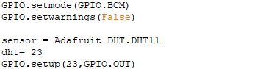
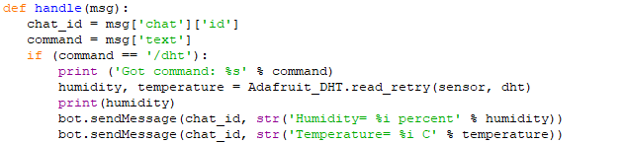
Adafruit DHT Sensor
Include libraries
Install necessary packages:
- Git clone https://github.com/adafruit/Adafruit_Python_DHT.git
- cd Adafruit_Python_DHT
- sudo apt-get install build-essential python-dev python-openssl
- sudo python setup.py install
Define GPIO mode and pins
Define handler function, LED output, and Bot response

Slide 17
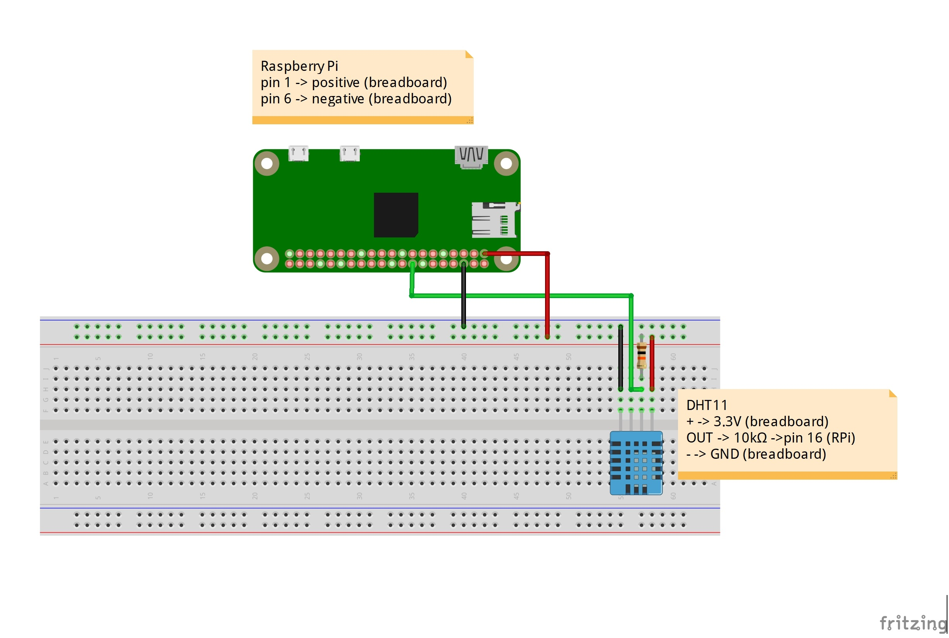
Circuit Diagram for DHT

Slide 18
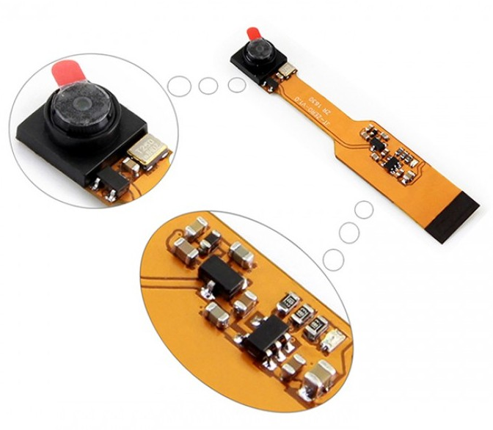
Pi camera
Raspberry Pi Camera, supports Raspberry Pi Zero V1.3 ONLY
5 megapixel resolution
Sensor best resolution : 1080p
Video record
Takes images
Notes:
Read more https://www.youtube.com/watch?v=OtvKGjJOmr4
https://rlx.sk/en/raspberry-pi/5324-rpi-zero-v13-camera-waweshare-raspberry-zero-v13-mini-camera.html

Slide 19
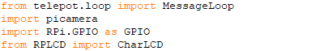
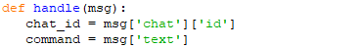
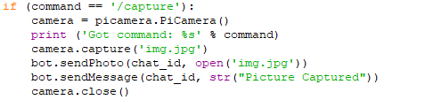
Capturing a picture with PiCamera
Include libraries
Install necessary packages:
sudo apt-get install python-picamera
Define message handler
Define command and Bot response

Slide 20
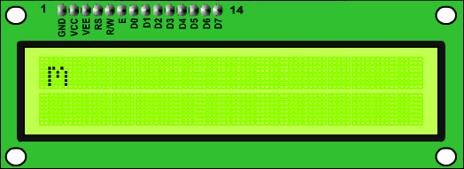
Liquid Crystal Display
Notes:
RS (Register shift): This pin is used to select whether data or an instruction is being transferred between the microcontroller and the LCD.
R/W (Read/Write): It determines the data direction
E (Enable): The E Clock is used to initiate the data transfer within the LCD.
The HD44780- based LCD unit can be operated in two modes, 8-bit and 4-bit mode. In 4-bit mode data is send using two four bit nibbles (First high four bits and then low four bits with an E Clock pulse with each nibble). The correct timing of the control signals is generated by software; therefore any AVR with at least seven free I/O pins can be used.Apart from the data-bus, 2 or 3 control-lines are needed, namely RS (Register shift), R/W (Read/Write) and E (Enable).
4-bit mode uses 4 I/O port pins for data and two or three additional I/O pins for control.
8-bit mode uses 8 I/O port pins for data and two or three additional I/O pins for control.
4-bit mode requires two 4-bit transfers for each instruction and character that is sent to the display.
8-bit mode requires only one 8-bit transfer for each instruction and character that is sent to the display.
The implication is that, 4-bit data transfers will take twice as much time to transfer as 8-bit data transfers.
4-bit data transfers use 4 I/O lines less then 8-bit data fransfers.
It is a trade off! You save up to 4 I/O lines using 4-bit mode over that of 8-bit mode but, the data transfer takes twice as long in 4-bit mode as it does in 8-bit mode.
If I/O is limited, 4-bit mode might be the way to go. If I/O is plentiful, but time is important, 8-bit mode may be the way to go.
4-bit data transfers also require a bit more code as, the lower nibble will need to be shifted into the upper nibble with each command and character transfer.

Slide 21
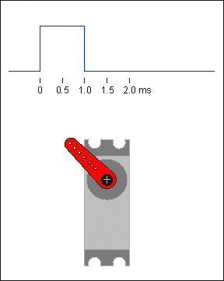
Servo motor
Push or rotate an object with great precision
PWM (Pulse width modulation)
Speed vs torque control
Fast, high torque, accurate rotation within a limited angle,
Suited for toy car, RC helicopters and planes, Robotics, Machine, etc..
Notes:
A servo motor is an electrical device which can push or rotate an object with great precision. If you want to rotate and object at some specific angles or distance, then you use servo motor.
If motor is used is DC powered then it is called DC servo motor, and if it is AC powered motor then it is called AC servo motor.
used in many applications like toy car, RC helicopters and planes, Robotics, Machine etc.
Servo motor works on PWM (Pulse width modulation) principle, means its angle of rotation is controlled by the duration of applied pulse to its Control PIN. Basically servo motor is made up of DC motor which is controlled by a variable resistor (potentiometer) and some gears. High speed force of DC motor is converted into torque by Gears.
Servo motors are generally an assembly of four things: a DC motor, a gearing set, a control circuit and a position-sensor (usually a potentiometer).
The position of servo motors can be controlled more precisely than those of standard DC motors, and they usually have three wires (power, ground & control). Power to servo motors is constantly applied, with the servo control circuit regulating the draw to drive the motor. Servo motors are designed for more specific tasks where position needs to be defined accurately such as controlling the rudder on a boat or moving a robotic arm or robot leg within a certain range.
Servo motors do not rotate freely like a standard DC motor. Instead the angle of rotation is limited to 180 Degrees (or so) back and forth. Servo motors receive a control signal that represents an output position and applies power to the DC motor until the shaft turns to the correct position, determined by the position sensor.

Slide 22
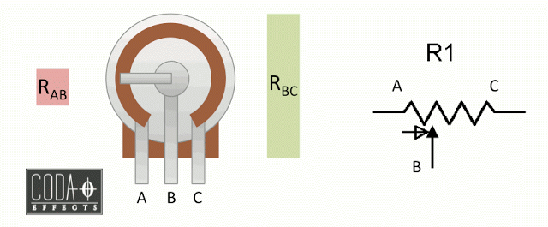
Potentiometer
Notes:
A potentiometer simply is a variable resistor! As resistors, its value is expressed in Ohms. Usually, potentiometers have a value between 1k and 10M. If you turn the potentiometer, its value will change. It has 3 lugs, named A, B and C (or 1, 2 and 3, respectively) .
Inside the potentiometer, there is a resistive track. When you rotate the potentiometer, the length of this resistive track varies between the lugs, and you vary the value of the resistance.
So when you rotate the potentiometer to the right, the resistance between A and B increases. When you rotate it to the left, it diminishes. Inversely, if you rotate it to the right, the resistance between B and C is reduced, and to the right it increases.

Slide 23
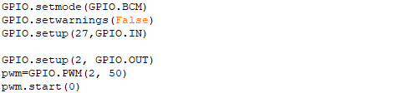
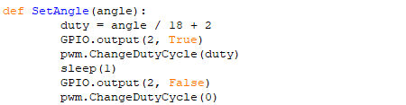
Simulating a door security mechanism
Include libraries
Install necessary packages:
sudo apt-get install python-picamera
sudo pip install RPLCD
Define GPIO mode and pins
Servo motor

Slide 24
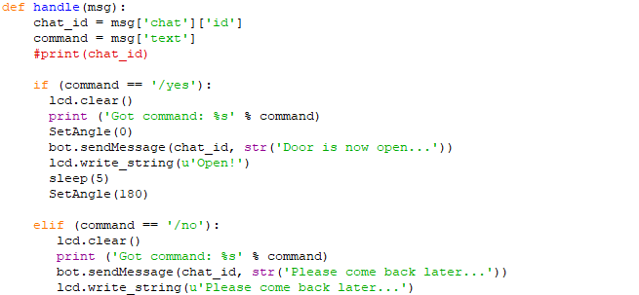
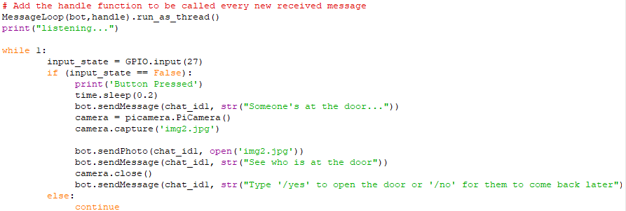
Simulating a door security mechanism Cont’d…
Define handler function, Servo output, and Bot response

Slide 25
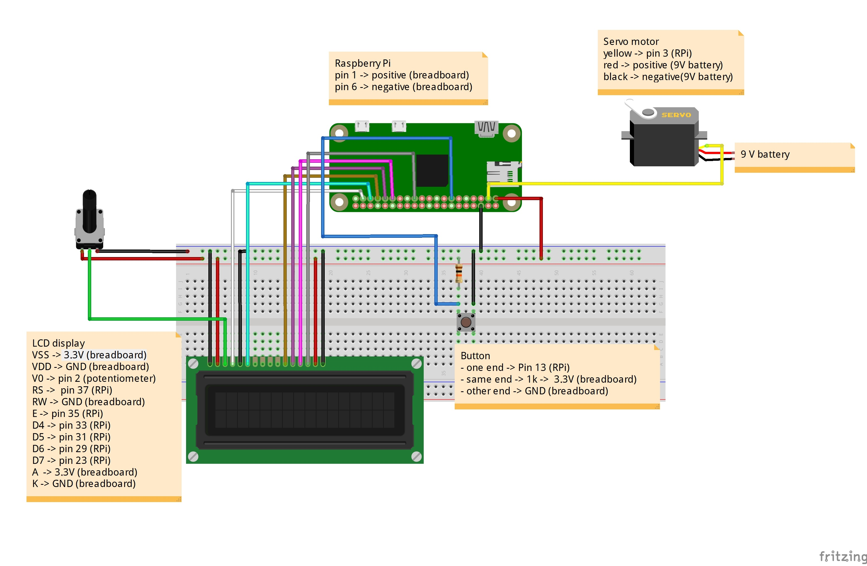
Circuit Diagram for Door Security Mechanism

Slide 26
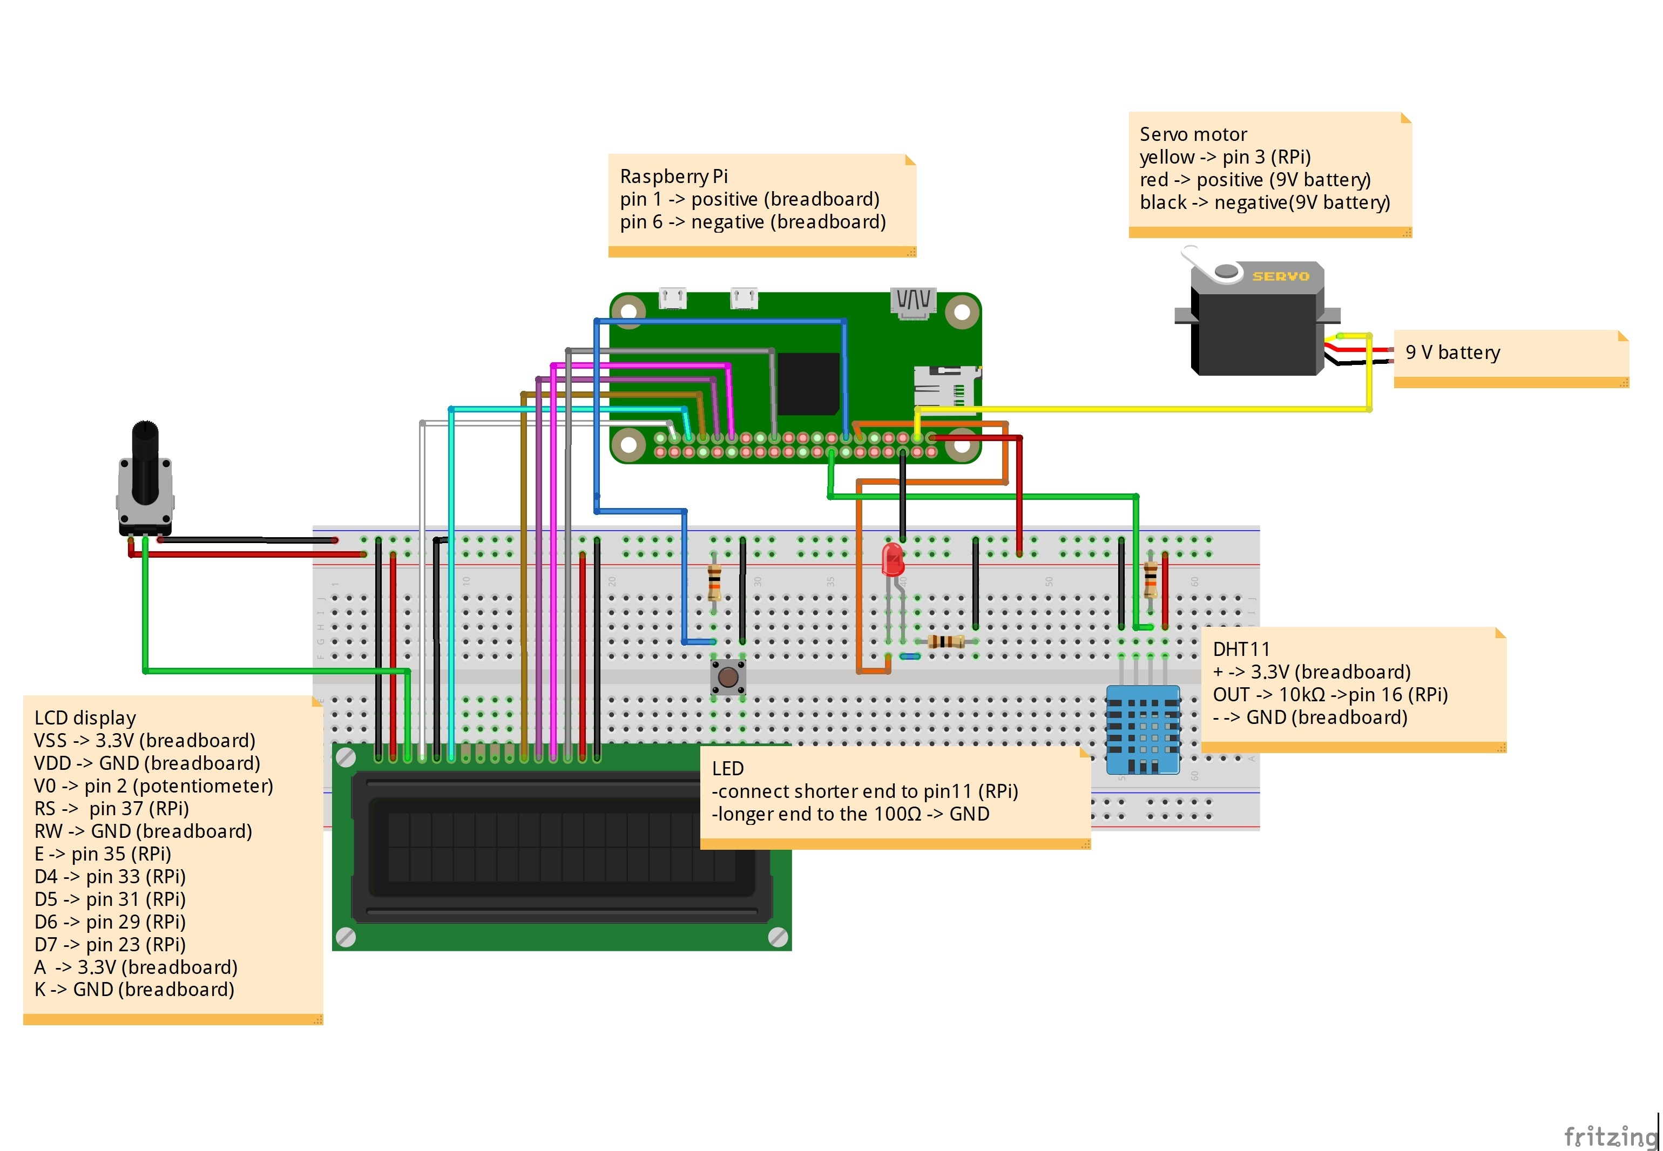
Implementing the entire system

Slide 27

THANK YOU
THANK YOU

